Slide 1
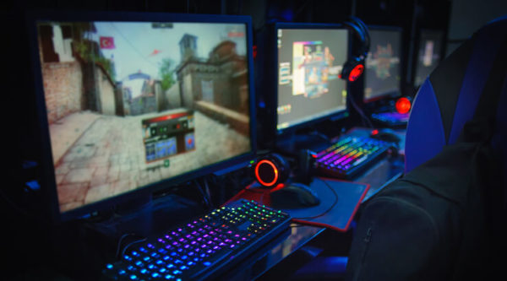

Gaming
This Photo by Unknown author is licensed under CC BY-SA-NC.

Slide 2




Gamer
Someone who plays games

Slide 3





Platforms
PC
Switch
PlayStation
Xbox
Mobile

Slide 4
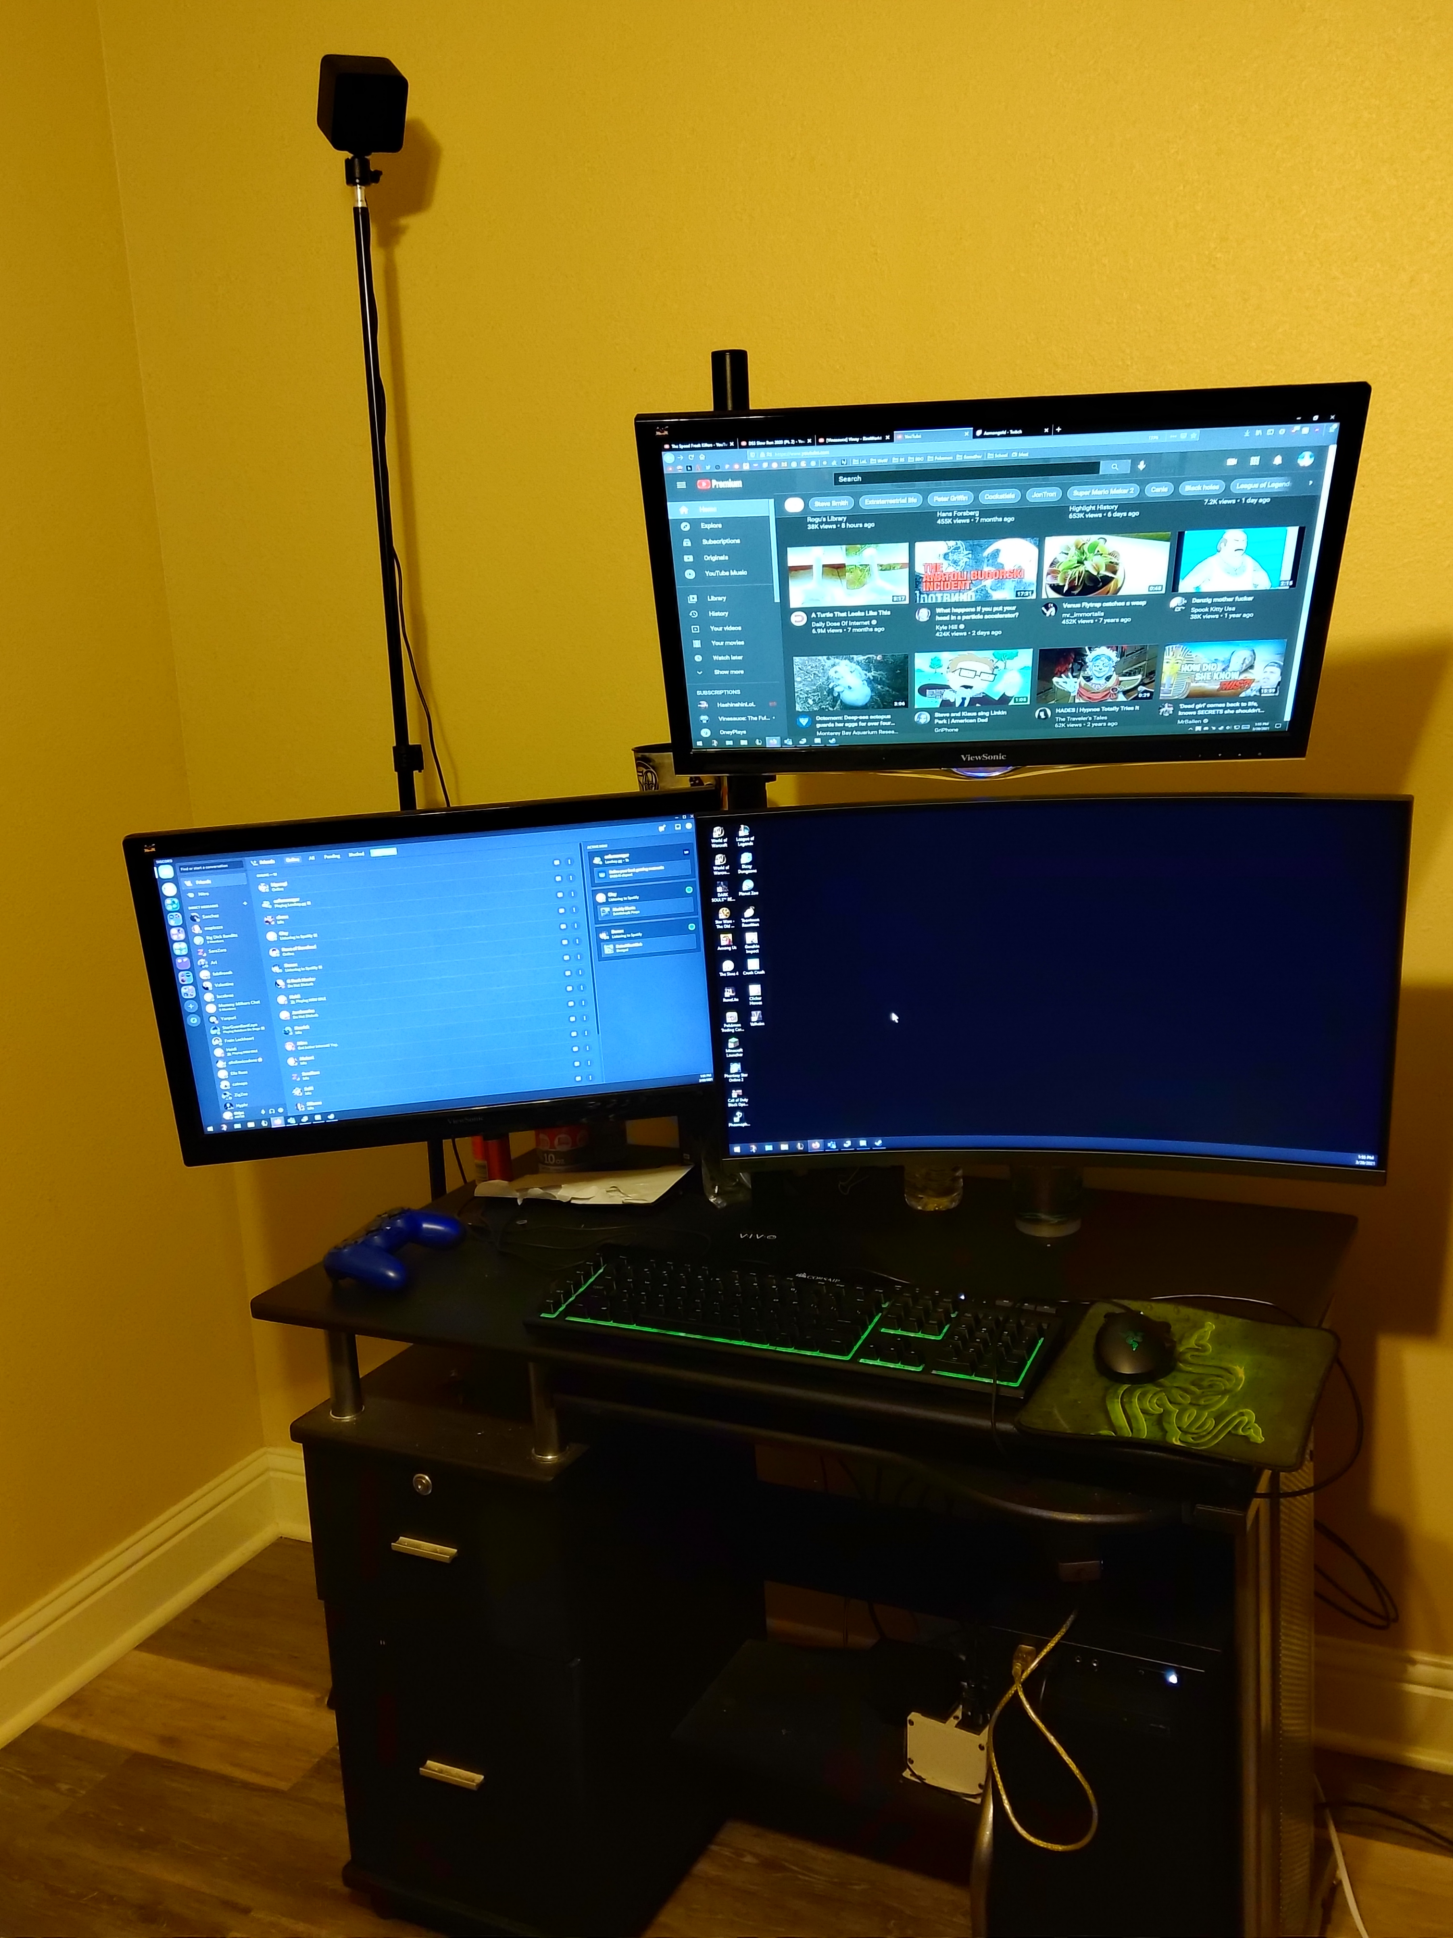
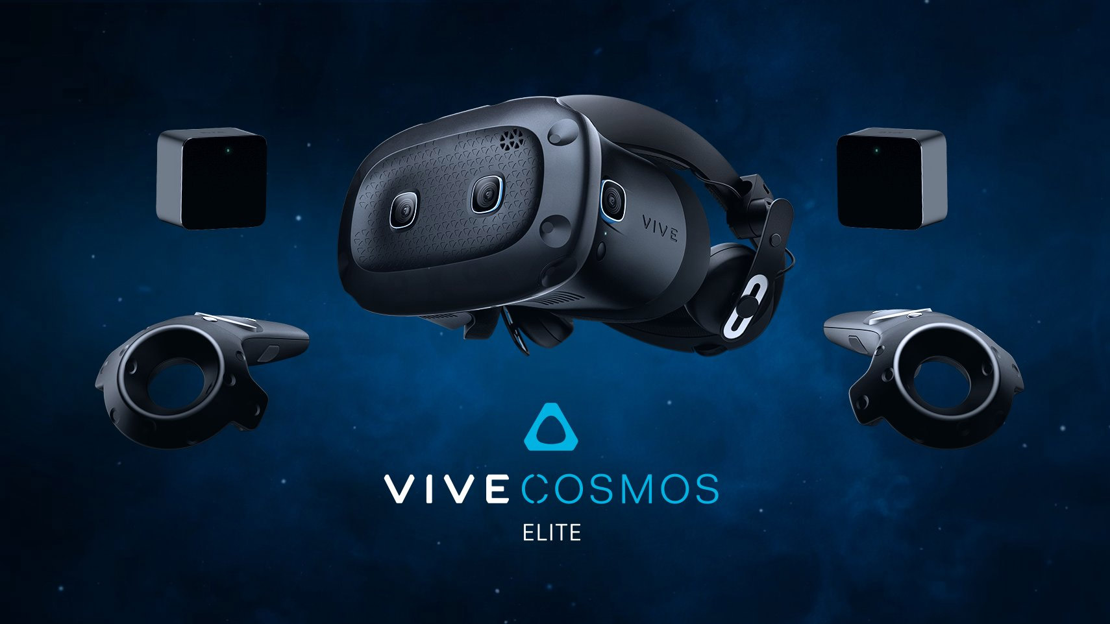
PC

Slide 5

PC Specs
Intel(R) Core ™ i5-9600k CPU
16 GB RAM
NVIDIA GeForce GTX 1660 Ti
ASUS PRIME 2370-A LGA 1151 (300 Series) ATX Motherboard
Corsair 500w Power Supply
500GB SSD, 500GB HDD, 2TB external HDD

Slide 6
Favorite Genres
Simulation
RPG (Role Playing Game)
MMO (Massively Multiplayer Online)
MOBA (Multiplayer Online Battle Arena)

Slide 7






Favorite Games
League of Legends
World of Warcraft
Dark Souls / Sekiro
Elder Scrolls Series
No Man's Sky
Genshin Impact

Slide 8
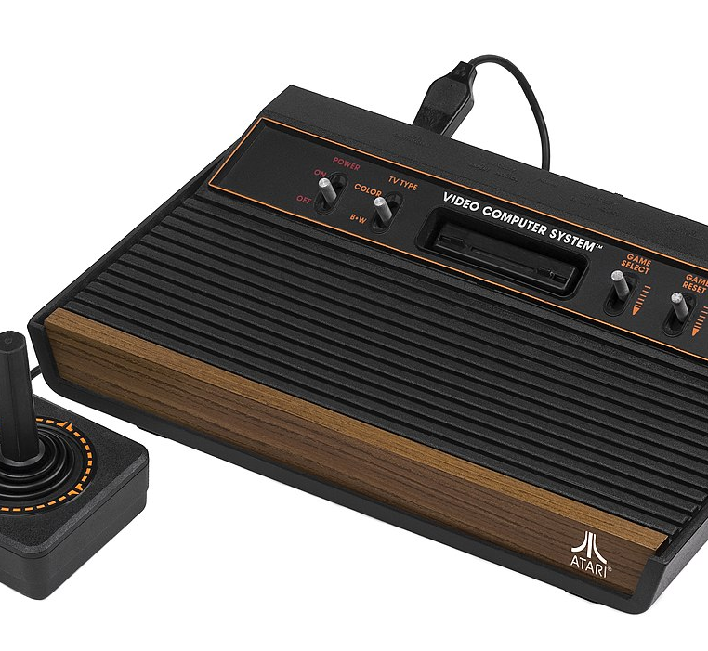
History of Video Games

Slide 9
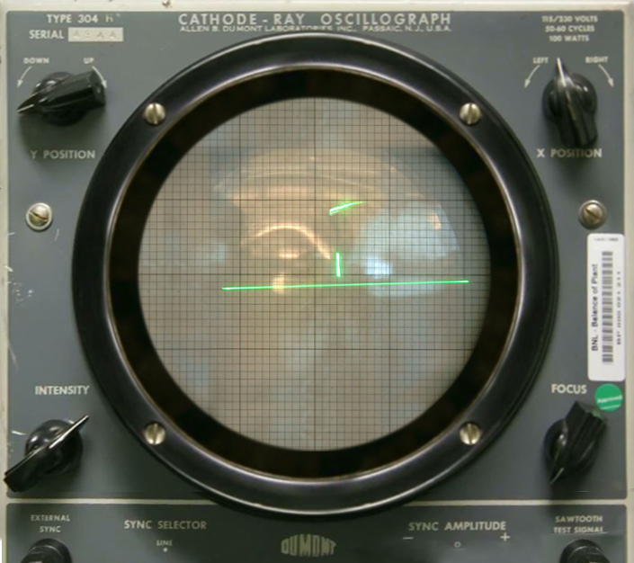
First Video Games
Tennis for Two (1958)
Spacewar! (1962)
Computer Space (1971)
Galaxy Game (1971)
Magnavox Odyssey Games (1972)
Pong (1972)

Slide 10
Video Game Crash of 1983
Saturation
Lost of Interest
Confidence of Consumers
Retailers Promoted Wrong Products
Rise of Affordablity of PC

Slide 11
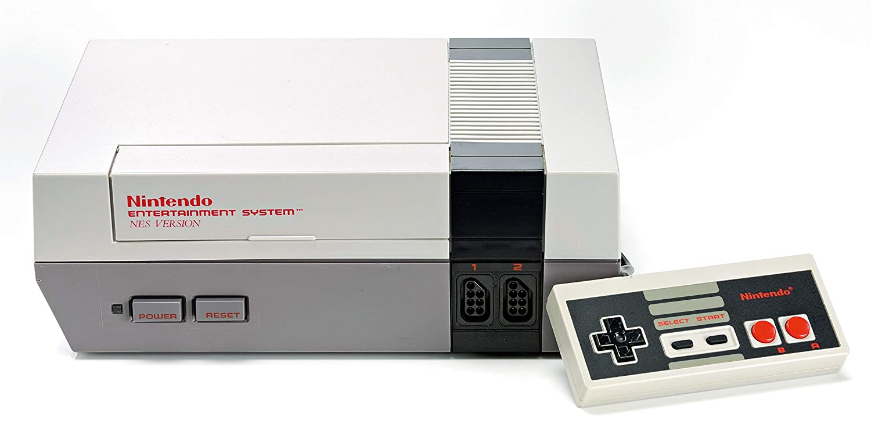
Saviour of Video Games
Nintendo Enterainment System (NES) (1985 in US)
Avoided mistakes of Atari
Quality Games

Slide 12

How Gaming Influenced Me
Developed small obssesion with technology
Wanting to learn more about the history
Career I enjoy

Slide 13
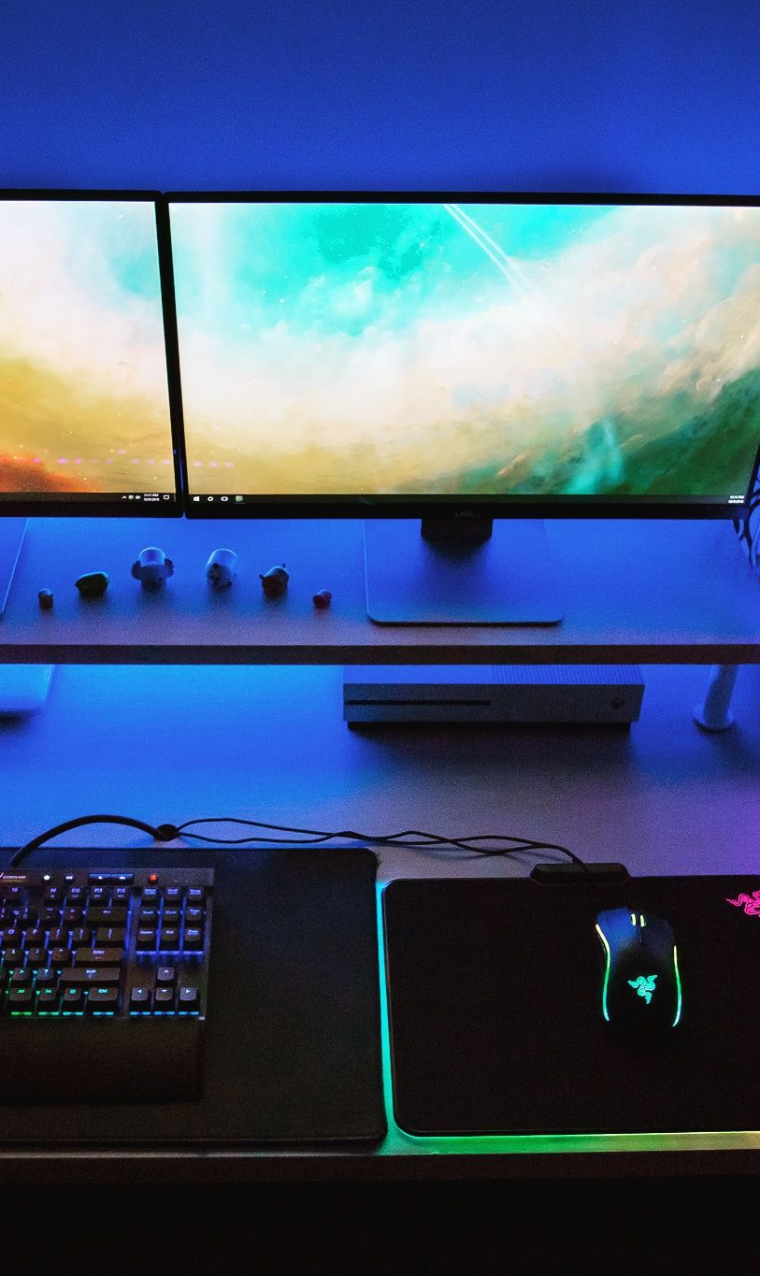
Motivation
Invest in my passion
Always learning
Challenging myself
Excited for the future

